Slide 1
Gravitational Many Body Simulation
Team Members:
Abhishek N N : 20BCE1025
Mayank Gupta : 20BCE1538

Slide 2
What and Why
In physics and astronomy, an N-body simulation is a simulation of a dynamical system of particles, usually under the influence of physical forces, such as gravity
N-body simulations are widely used tools in astrophysics, from investigating the dynamics of few-body systems like the Earth-Moon-Sun system to understanding the evolution of the large-scale structure of the universe.^{[1]} In physical cosmology, N-body simulations are used to study processes of non-linear structure formation such as galaxy filaments and galaxy halos from the influence of dark matter. Direct N-body simulations are used to study the dynamical evolution of star clusters.

Slide 3
Project plan
Develop a program to simulate gravitational forces between n bodies in space
Parallelizing the program with OpenMp
Exploiting the massively parallel architecture provided by GPUs using CUDA.

Slide 4
Tools and Technology:
Language serial : Python
Language parallel/gpu :C/C++
Output and Graphics : OpenGL
Parallelization : OpenMP
GPU programming : CUDA
Platform : Linux
IDE : Visual Studio Code

Slide 5
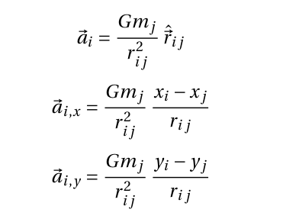
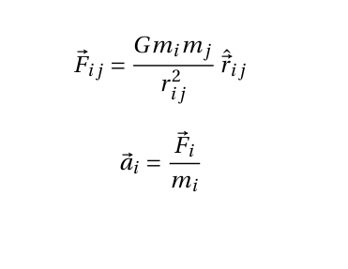
All-Pairs Algorithm
The gravitational N-Body problem relies on two of Newton’s Laws– Newton’s Law of Gravitation, as in (1); two bodies, B i and B j of mass m i and m j are attracted to
~i j , which is inversely proportional each other by a force F to the square of the distance between them, r i j (G is Universal Gravitational Constant) and Newton’s Second Law of Motion, as in (2); a body, B i , of mass m i will experience an acceleration, ~a i , if it experiences a force of ~i (force due to all the bodies in the system,

Slide 6
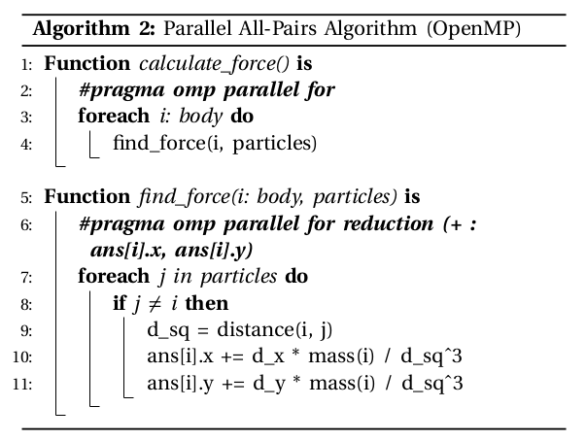
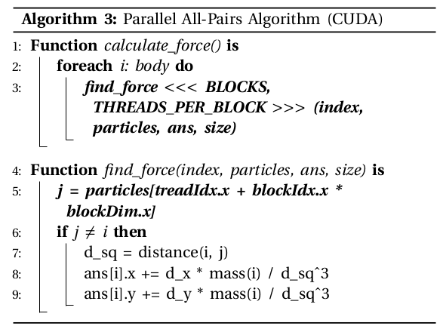
Algorithm

Slide 7
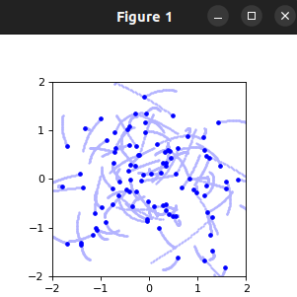
Implementaion
Python implementation for serial is completed
Parallel and GPU implementation in C/C++ is pending

Slide 8
References
http://cppreference.com/
https://learnopengl.com/
https://www.openmp.org/wp-content/uploads/openmp-examples-4.5.0.pdf
https://github.com/PacktPublishing/Learn-CUDA-Programming
https://developer.nvidia.com/nsight-visual-studio-code-edition

Slide 9
THANK YOU

